Slide 1
Store Sales Analysis DEPI Graduation Project

Slide 2
Whoa!

Slide 3
Esraa Adel | Data cleaning-Analysis question-Data forecasting-Dashboard
Dina Mohamed | Date forecasting-Dashboard
Shahd Emad | Date forecasting-Dashboard
Yomna Hatem Eltaie | Data cleaning-Data forecasting-Dashboard)

Slide 4
Table of contents
01
02
03
04
Data Overview
Data Cleaning
Analysis Questions
Visualization Dashboard
05
Forecasting Questions
06
Key Insights & Conclusions

Slide 5
01
Data overview

Slide 6
Contents of this template
Orders | Customers | Region | Products
Order id Order date Ship date Ship mode | Customer id Customer name Segment | Country City State Postal code Region | Product id Product name Category Sub-category Sales

Slide 7
02
Data cleaning

Slide 8
In the Data Cleaning stage, the focus is on preparing the data for analysis by:
Removing or imputing missing values.
Eliminating duplicate entries.
Formatting data consistently (e.g., dates, numbers).
Standardizing inconsistent labels.

Slide 9
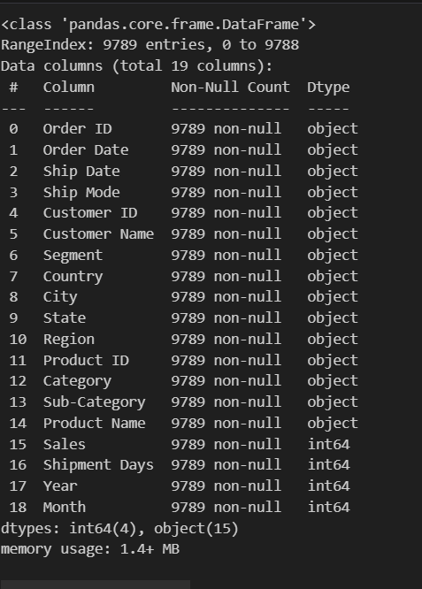
Data
Before
Cleaning:

Slide 10

What are we going to clean the data?
Import Pandas library and data file to start cleaning data

Slide 11
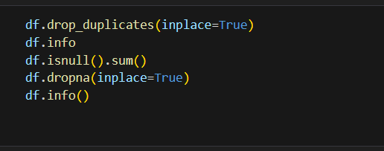
Remove duplicates and nulls

Slide 12
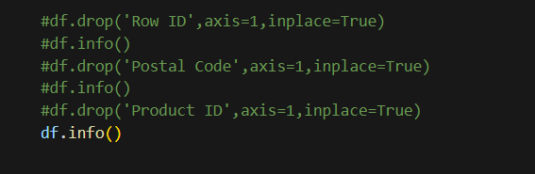
Remove unnecessary
information

Slide 13
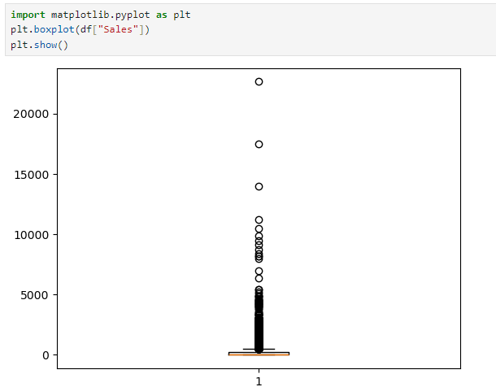
Remove out liers

Slide 14
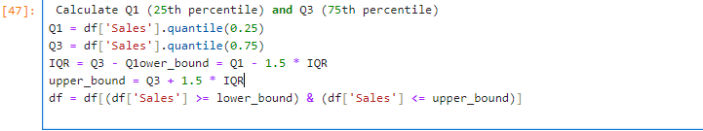

Slide 15
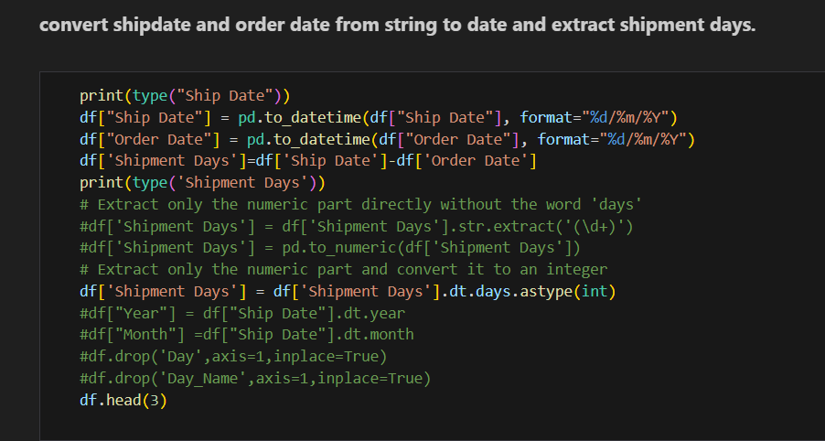
Change type of ship date
And Order date

Slide 16
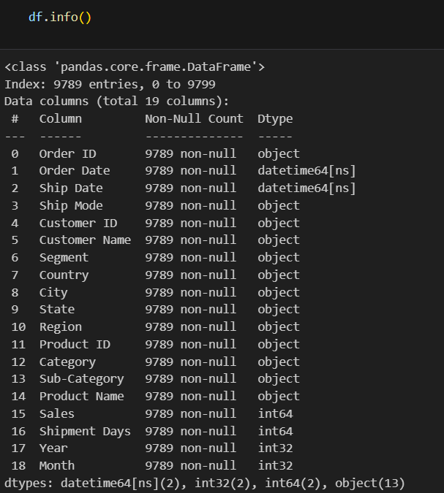
Data after Cleaning

Slide 17
03
Store Sales Data Analysis Questions

Slide 18
What is the total sales across all regions?
Which product category or sub-category generates the highest sales?
What is the sales trend over time?
Which customer segments contribute the most to sales?
What is the correlation between sales and different shipping modes?
How does sales volume fluctuate seasonally?

Slide 19
Which products generate the most revenue despite lower quantities sold?
What is the sales forecast using historical data?
What regions or cities have the highest sales?
Which customer segments have the highest repeat purchase rates?
How does shipping mode impact delivery time and customer satisfaction?
Which product categories show the most growth in sales over time?

Slide 20
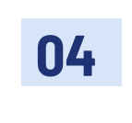
Dashboard

Slide 21
Key Performance Indicator( KPI )

Slide 22
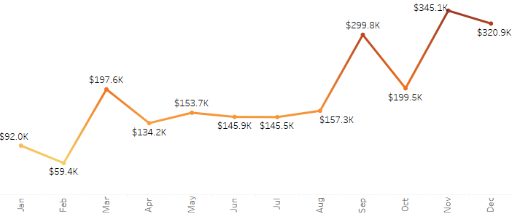
Sales over Months

Slide 23
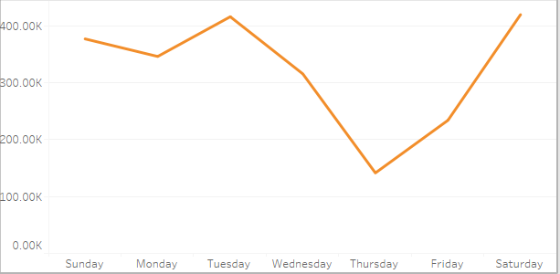
Sales over weekdays
Weekend has shown the highest sales, however, midweek has shown the least sales

Slide 24
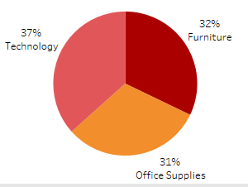
Sales per Category
The Technology category has recorded the highest sales, accounting for 37%

Slide 25
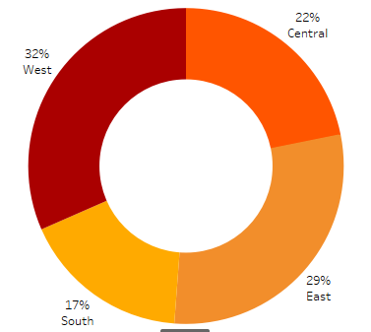
Sales per Region
While all regions have similar sales percent, the West region has recorded the highest sales by 32%

Slide 26
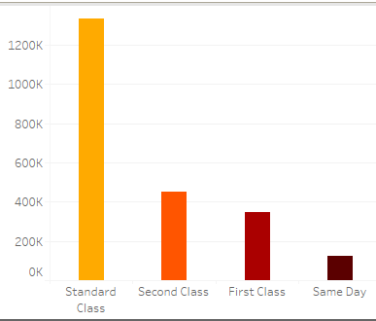
Sales of Shipping Modes
Stander class has recorded the highest sales, accounting for more than 1M$

Slide 27
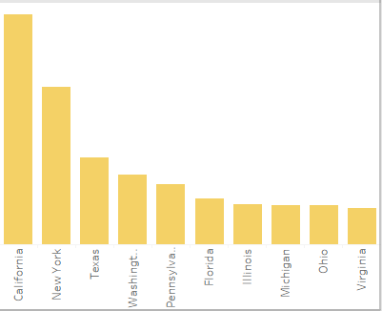
Top 10 States
California and New York have recorded the highest sales

Slide 28
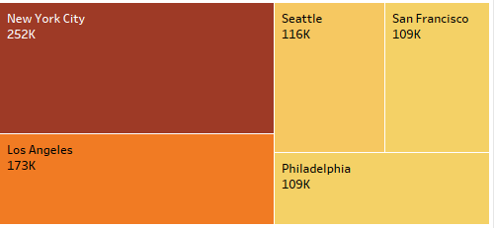
Top 10 Cities
New York city has recorded the highest sales by nearly 252k$

Slide 29
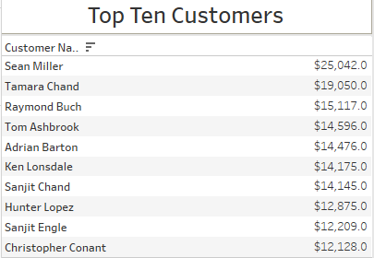
Top 10 Customers

Slide 30
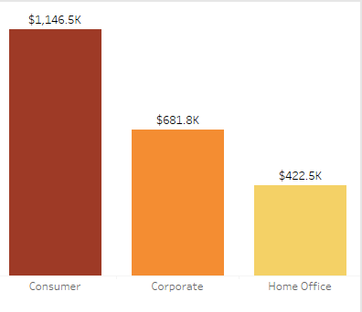
Top 10 Segments
Consumers have the highest sales among other segments by more than 1M $

Slide 31
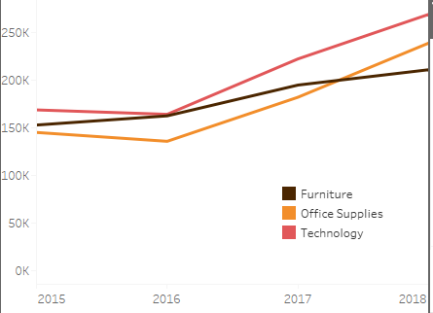
Sales by Categories
There has been a significant increase in sales across various categories over the years.

Slide 32
Forecasting Questions
05

Slide 33
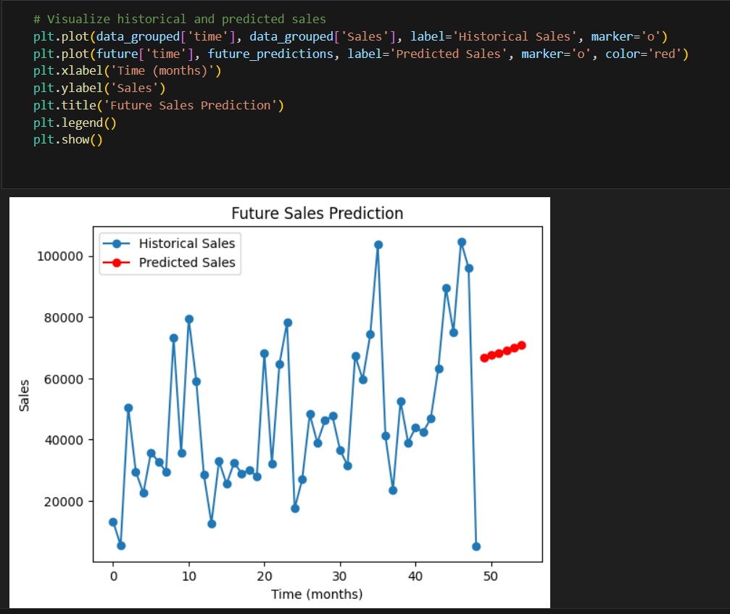
1. Analyzing and Predicting Future Growth Over time

Slide 35
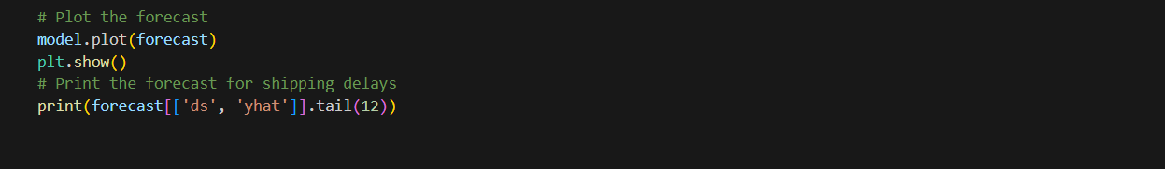
2. Analyzing and Predicting Future of shipping days

Slide 36
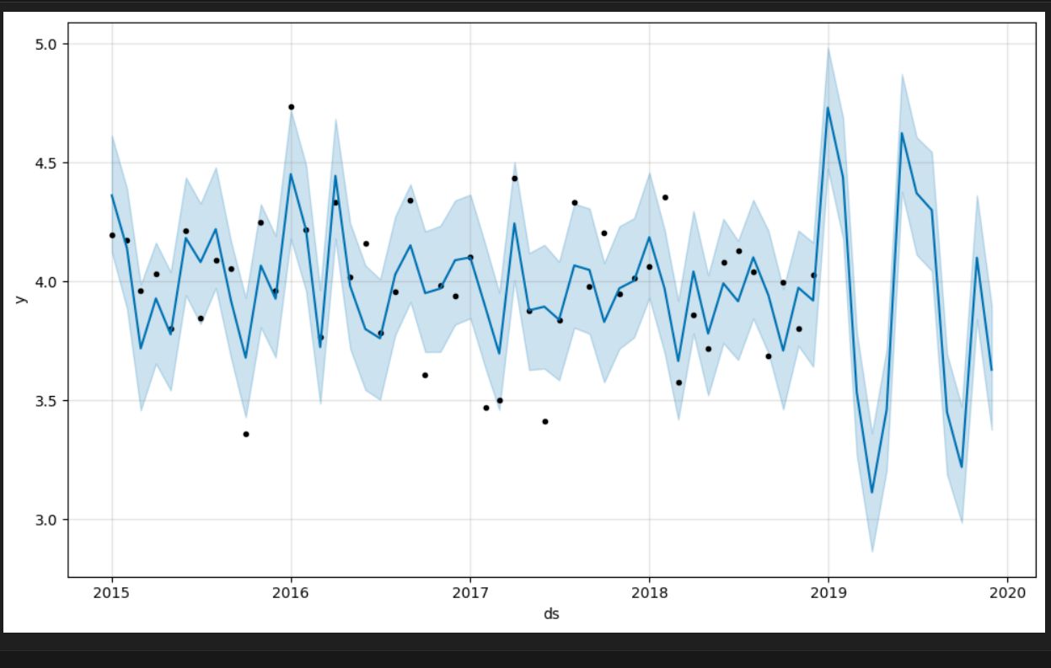

Slide 37
Conclusion and Key insights
06

Slide 38
This dashboard provides a clear and comprehensive view of store sales performance, highlighting critical metrics to support data-driven decision-making. This tool empowers managers to optimize sales strategies, streamline operations, and boost overall performance
Conclusion

Slide 39
.Key features
Sales Trends: Tracks sales patterns over time to identify growth opportunities and seasonal trends.
Category Performance: Analyzes sales by product category, pinpointing high and low performers.
Shipment Insights: Monitors shipping modes and delivery efficiency to improve logistics.
Revenue Drivers: Identifies top-selling products and key revenue sources..

Slide 40
Time for Questions

Slide 41
Thanks!

